Slide 1

WELCOME TO JĒKABPILS, BARONI SPORT COMPLEX
20.-21.06.2026
DRIVER BOOKLET V1

Slide 2

LATVIA DRIFT OFFICIAL CHAT FOR THIS EVENT:
https://chat.whatsapp.com/HDO1YszvJWsL1TPBx1v3kZ

Slide 3

REGISTRATION FOR RACE
REGISTRATION ONLINE FOR DRIVERS – PLEASE CHECK PAYMENT PHASES:
https://forms.gle/U21QcwyC5G1x7hgo7
Supplementary regulations you can find in and SPORTITY:
http://www.driftlatvia.com/dalibniekiem/dokumenti/
PLEASE REGISTER ON TIME
ENTRY FEE: STARTING FROM 175 EUR
Entry fee may vary depending on the registration phase.

Slide 4
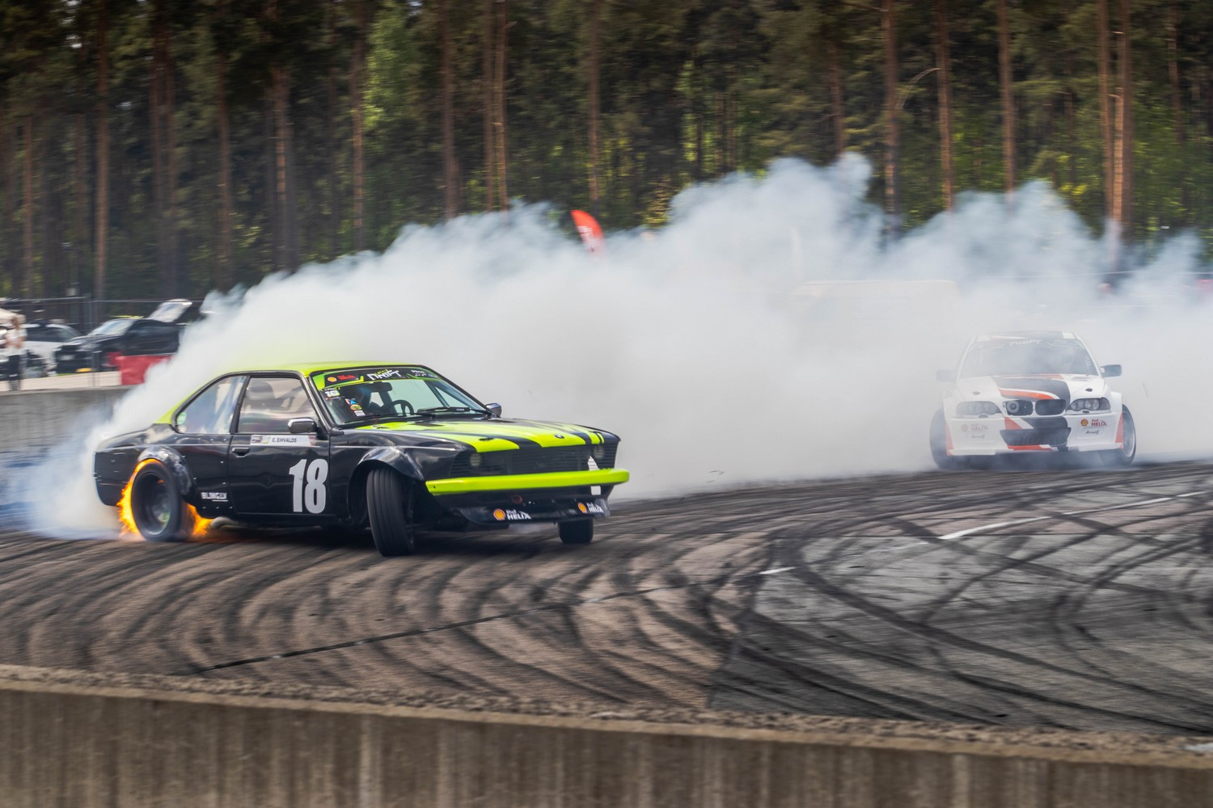
FOR MEDIA
REGISTRATION FOR MEDIA ARE OPEN UNTIL 10.06.2026
https://www.driftlatvia.com/medijiem/mediaaccreditation/
Media representatives who have already filled out the season application form and marked accreditation for the DRIFT Party in Baroni do not need to submit an additional accreditation request.

Slide 5

DRIVER INFORMATION
BARONI DRIFT PARTY | EVENT 2 | LATVIA | SPORT COMPLEX BARONI, JĒKABPILS
This driver information booklet document contains all information you, as a driver, and your team should need to know about this event, including
LATVIA DRIFT CHAMPIONSHIP PRO2 CLASS 2ND STAGE
LATVIA DRIFT CHAMPIONSHIP STREET CLASS 2ND STAGE
CHAMPIONSHIPS ARE OPEN TO DRIVERS FROM ANY COUNTRY!
Should you have a question about anything either contained in this document please contact, Elīne Berķe Bluša by email at eline@driftlatvia.com
Please note that this document is for informational purposes only. The basic competition document is the competition regulations.
Based on the fact that this document is for informational purposes only, this document is written in English. Thank you for your understanding.

Slide 6

RACE TIME SCHEDULE V1
19.06.2026 FRIDAY 17:00-23:00 OPEN PADDOCK, FULL TIME TABLE PLEASE CHECK IN REGLAMENT
20.06.2026 SATURDAY
SATURDAY 20.06.2026
08:30-09:50 REGISTRATION JUST FOR PRO2 CLASS
08:40-09:40 TECHNICAL JUST FOR PRO2, IN ROW
10:00-14:00 STREET REĢISTRĀCIJA
10:00-14:00 STREET TEHNISKĀ KOMISIJA
10:00-11:00PRO2 PRACTICE
11:00-11:40 PRO2 BRIEFING
11:50-12:50 PRO2 PRACTICE
13:00-14:00 PRO2 QUALIFICATION
14:20-16:20 STREET PRACTICE
14:05 PRO2 BRIEFING – TANDEMS
16:30-17:10 STREET BRIEFING
17:20-19:20 STREET PRACTICE
19:30-21:30 STREET QUALIFICATION
21:30 STREET BRIEFING TANDEMS

Slide 7

SUNDAY 21.06.2026
9:00 – 9:50
STREET X TANDEM PRACTICE
10:00 – 12:00
STREET X TANDEMS
12:10 – 13:00
PRO2 TANDEM PRACTICE
13:00
OPENING CEREMONY
13:40 – 15:50
PRO2 TANDEMS
16:00 – 16:50
STREET TOP32 TANDEM PRACTICE
17:00 – 19:30
STREET TANDEMS
19:40
PRIZE GIVING CEREMONY
19:50
DRIVERS AFTER-RACE BRIEFING (NOT MANDATORY)
Breakfast options will be available at the track in the morning.
Please note that the agenda may be changed depending on the number of registered participants. By monitoring the registration process, the organizer monitors whether the track time is appropriate for the number of participants. If the agenda is changed, the organizer will inform all registered drivers about it no later than 10.06.2026.
Additionally, the organizer informs if the agenda suddenly changes drastically, including the fact that an additional day may be added, the organizer will inform the drivers about this no later than 1 week in advance.

Slide 8
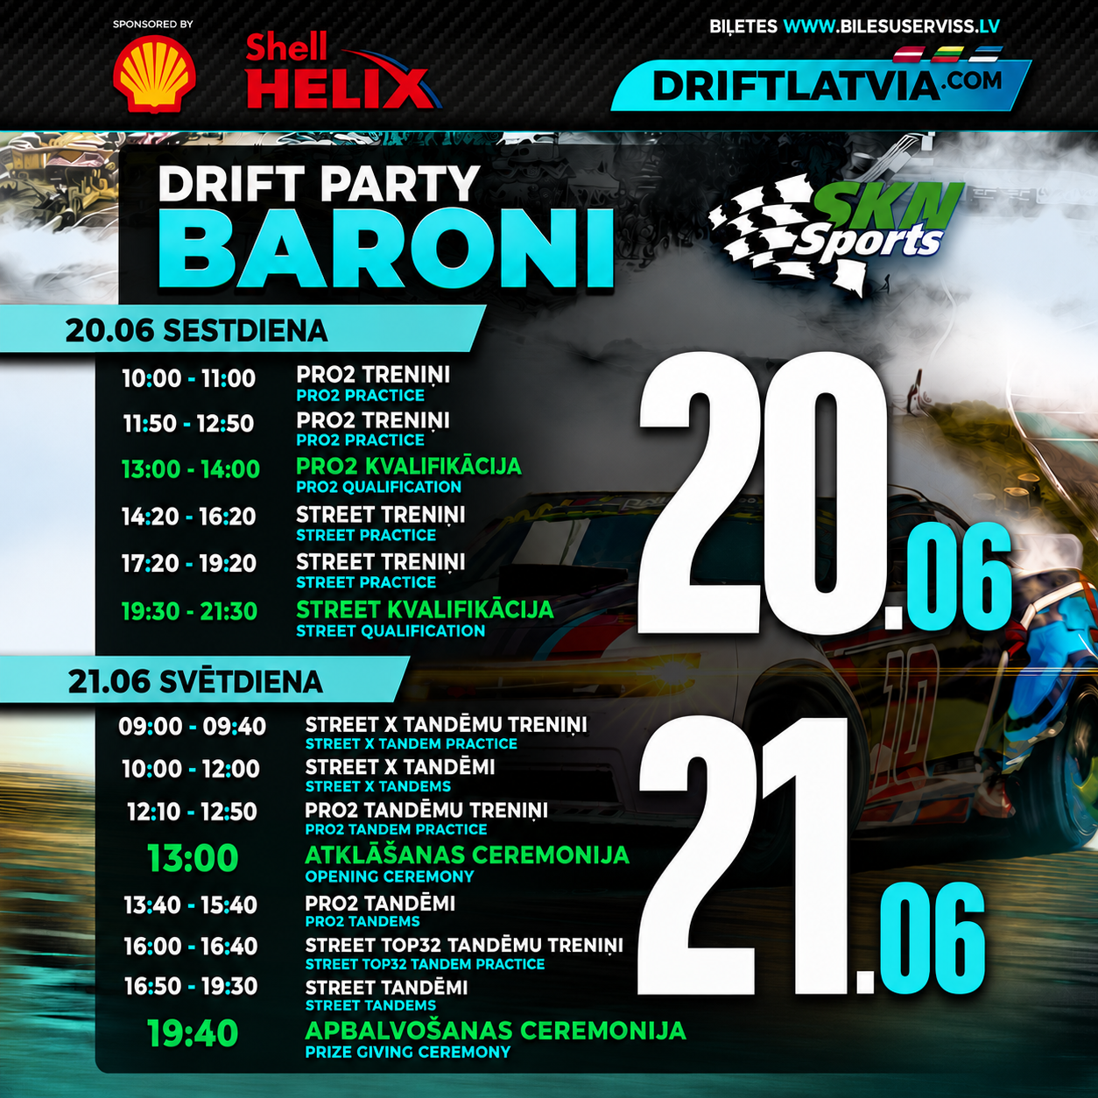

Slide 9

“ BARONI” RACE TRACK, JĒKABPILS,BIRŽI
Race track address:
Baroni, Birži, Salas pag., Jēkabpils novads.
GPS cordinates: 56°24′16″N 25°47′46″E
LAYOUT

Slide 10
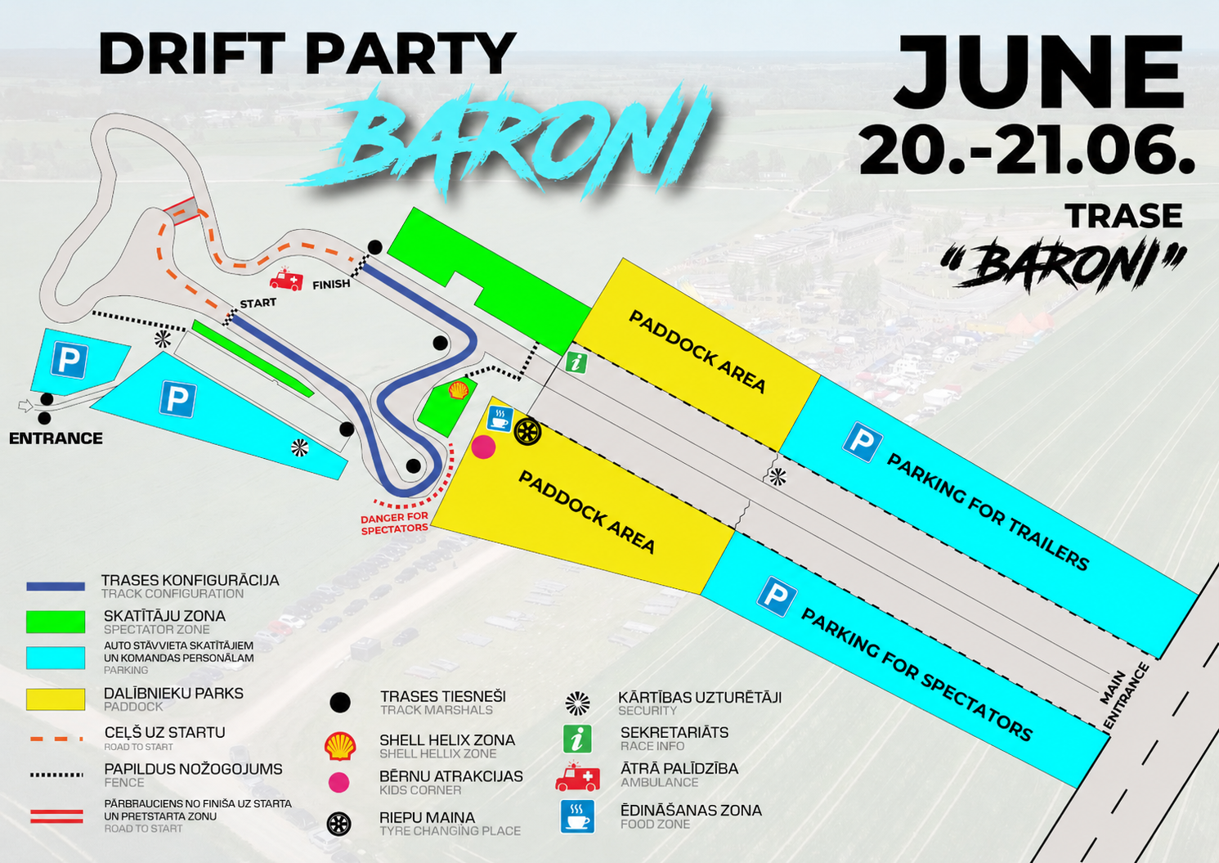

Slide 11
OFFICIALS
Race Director: Jānis Blušs
Steward: Elīne Berķe Bluša
Clerk of the course: Gunārs Ķeipāns vs Elīne Berķe Bluša
Secretary of the Competition: Laila Ķeipāne
Chief scrutineer: Dainis Akmentiņš
Judges: Coming soon

Slide 12

PADDOCK
FRIDAY 17:00-23:00
SATURDAY 07:00-23:00
SUNDAY 08:00-23:00
WHEN YOU ARRIVE AT THE TRACK:
Please use the main entrance at all times – it is located closer to the paddock! DON’T USE ANOTHER ENTRANCE
Drivers are allowed to leave their cars overnight in the participant park. However, do not leave any valuable or important items in the pit area – these should be stored in the technical car.
Drivers are permitted to stay overnight in the paddock, built tents and campers, but not first line in paddock.
Most drivers usually stay overnight at this track, and this will be possible again this time.
The organizer strictly informs that lighting grills or similar equipment in the pits or anywhere on the track is strictly prohibited during the competition. This is only permitted after the competition ends and only under full compliance with basic safety regulations. The organizer also informs that security may carry out random checks on technical vehicles to verify that no HEAVY alcohol is being brought into the race area.

Slide 13
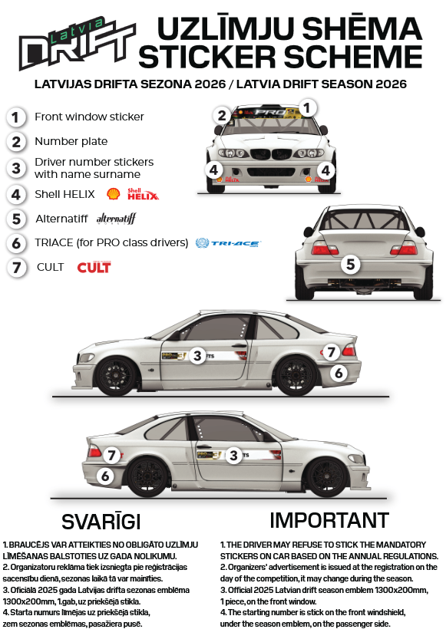
STICKER SCHEME

Slide 14
TECHNICAL COMMISSION INFORMATION
There will be technical inspection at Round, so pleami remember to check and comply with all rules & regulations and take care to note both- the noise regulations and the maximum tire size. Technical inspection will be available every day, in timing based on schedule.
Please plan your time for the technical commission and be on the time with your car, without a sticker of the technical commission, the permission for training will be denied!
If you need to contact the technical commissioner during the competition, please call him: +37129560050 Dainis
TIRE SIZES
STREET MAX 205 STREET TIRE
PRO2 MAX 225 STREET TIRE
PRO2 TIRE RULE - MAX 225- STREET TIRES
PRO2
Maximum tread width of the rear tyres is 225 mm
Front tyres are free
Only the street legal rear tyres is allowed.
It is not allowed to use semi-slick and full slick tyres
Eligibility of the tyres is checked during the competition at the line-up area.
If there is any doubt about the suitability of the tire, send a clarifying question to dableds@gmail.com Technical control can also send the competitor back from the starting line, in case the competitor makes a mistake with the tire rule. In the season 2025 it is prohibited to use semi-slick or full slick tyres. If you have doubts about tyres you intend to use, please send the questions to dableds@gmail.com to avoid unnecessary problems at the scrutineering. If the driver violating the tyre regulations, scrutineers can eliminate the driver even from line-up.

Slide 15
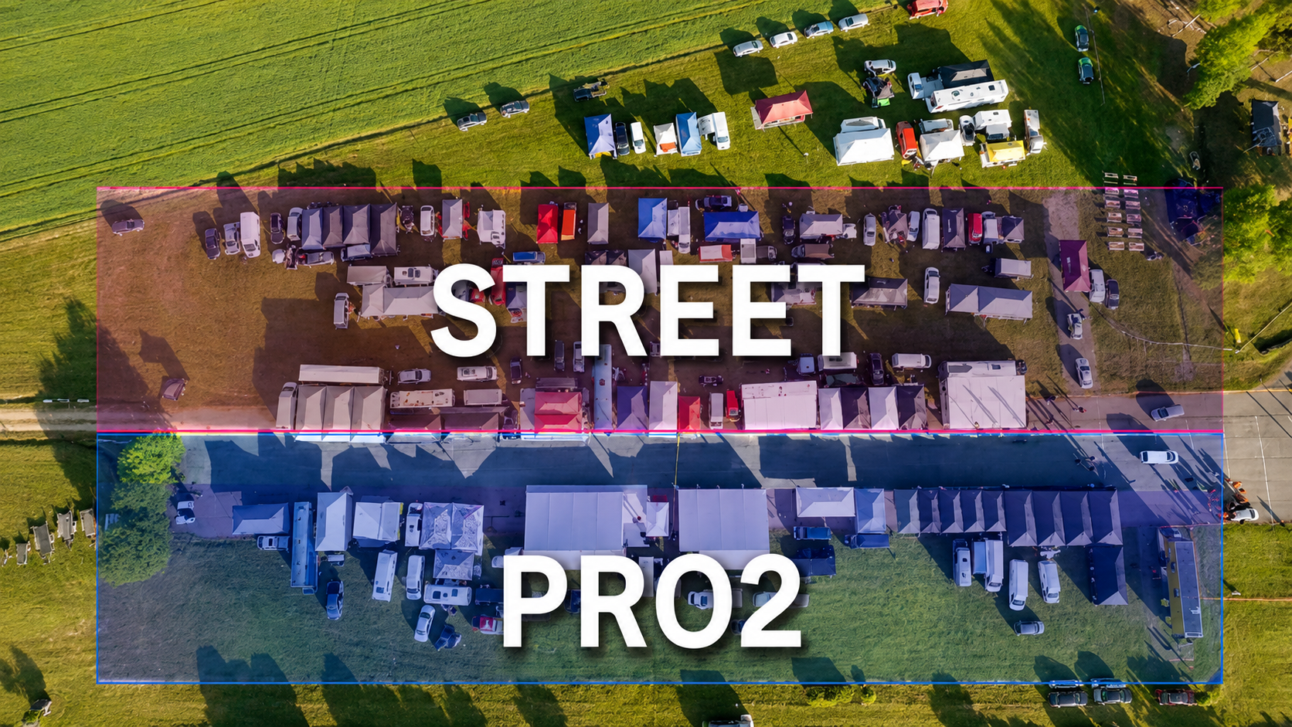
IMPORTANT
IMPORTANT INFORMATION FOR PARTICIPANTS AND TEAMS ABOUT PADDOCK
Drivers and their teams are allowed to spend the night in the participants’ park and may begin setting up tent
sites starting from Friday evening.
Please note that this track does not provide any additional amenities such as showers or electricity.
If you require electricity, you must arrange it yourself.
This time, the paddock will be shared between Street and Pro2 classes.
Please respect PADDOCK layout and arrangement:
One side will be allocated for Street class, and the other for Pro2 class.
There will be multiple paddock lines, so please be aware that some teams will be placed
on grassy areas.
Participants arriving with campers will be asked to park in the second or third paddock line,
allowing you to organize your area comfortably without blocking access to the start line for
other drivers. Please leave gates middle paddock, check plus minus 6-8 paddock places, if you are
in front row, and leave empty space for 2nd and 3rd row!
Within each paddock line, the race car must be placed in front, followed by your tent, bus, or
any other vehicle or sleeping area behind. The front line is for race cars only no busses or
worst even private cars!
We kindly ask all teams to follow these guidelines to ensure
a smooth and respectful experience for everyone involved.

Slide 16
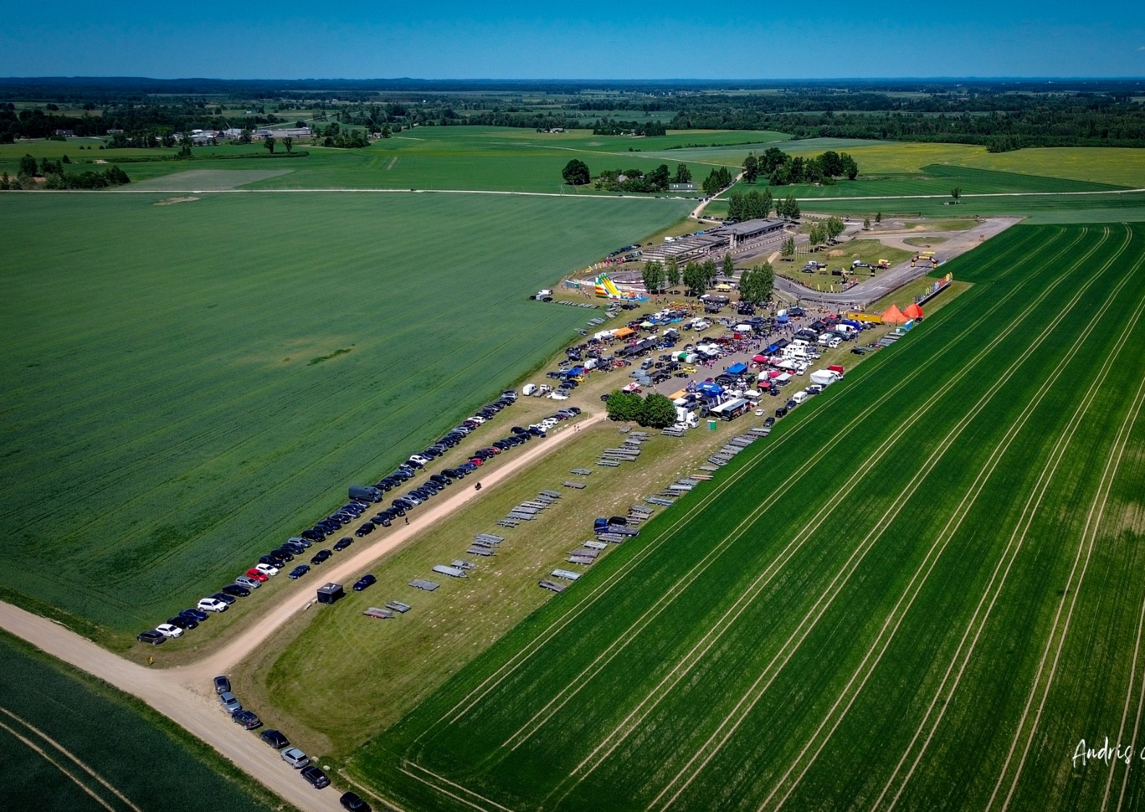
THERE WILL ALSO BE SEPARATE TRAILER ZONE IN LINE 3 BUT NOT AFTER PADDOCK, BUT IN DEEPER CORNER, NEXT TO THE ENTRANCE IN PRO2 PADDOCK SIDE, AND PLEASE ALWAYS FOLLOW UP ORGANIZER UPDATES IN OFFICIAL GROUPS!
PLEASE PUT TRAILERS AS YOU SEE IN PICTURE, STARTING FROM ENTRANCE TENT!!!!

Slide 17
NOISE
Exhaust system - exhaust system starting from the cylinder head is not regulated, as long as the 100 dB(A) at 4500 RPM noise level (+3dB(A) possible error), measured in accordance with FIA noise measurement method, is not exceeded...”
No car is permitted to be drifted between the hours of 9:00pm (21:00) to 9:00am. Please also remember that it is also forbidden to take your competition vehicle onto the open road, and take a ride without informing race organizer and official marshals into the track area.
Music on the paddock must quiet at 11:00pm (23:00).
THERE ARE QUIET HOURS FROM 23:00 PM-09:00 AM
AND PLEASE UNDERSTAND IF YOU FIX YOUR CAR IN PERIOD MENTION UP, ITS PROHIBITED TO TEST IT, MAKE TESTS, MAKE SOUND, PENALTY 500 EUR, so please don’t do anything without permission!
AND ALSO JUST SMALL REMINDER ABOUT «POP- CORN» RULE, THIS IS NOTE TO READ REGULATION!

Slide 18
USEFUL INFO
There will be tire-changing crew, which will work at the place. Tire fitting is included in the entry fee! The tire assembly will be located in the paddock.Tire changing will work as in Saturday as in Sunday!
Please do not leave your tires at the tire fitting, hoping that the fitters will do the feeding and inspection of the tires for you! if there is no person with the tires, but someone gives the tires,
DRIVER BRIEFING AREA
Drivers 'meetings will take place in a separate area- the drivers' meeting place, under Latvia drift tent.
The place will be located close to race secretary place.
CLOSEST HOSPITAL:
Jēkabpils reģionālā slimnīca A.PORMAĻA 125, Jēkabpils, LV-5201 13,2 k

Slide 19
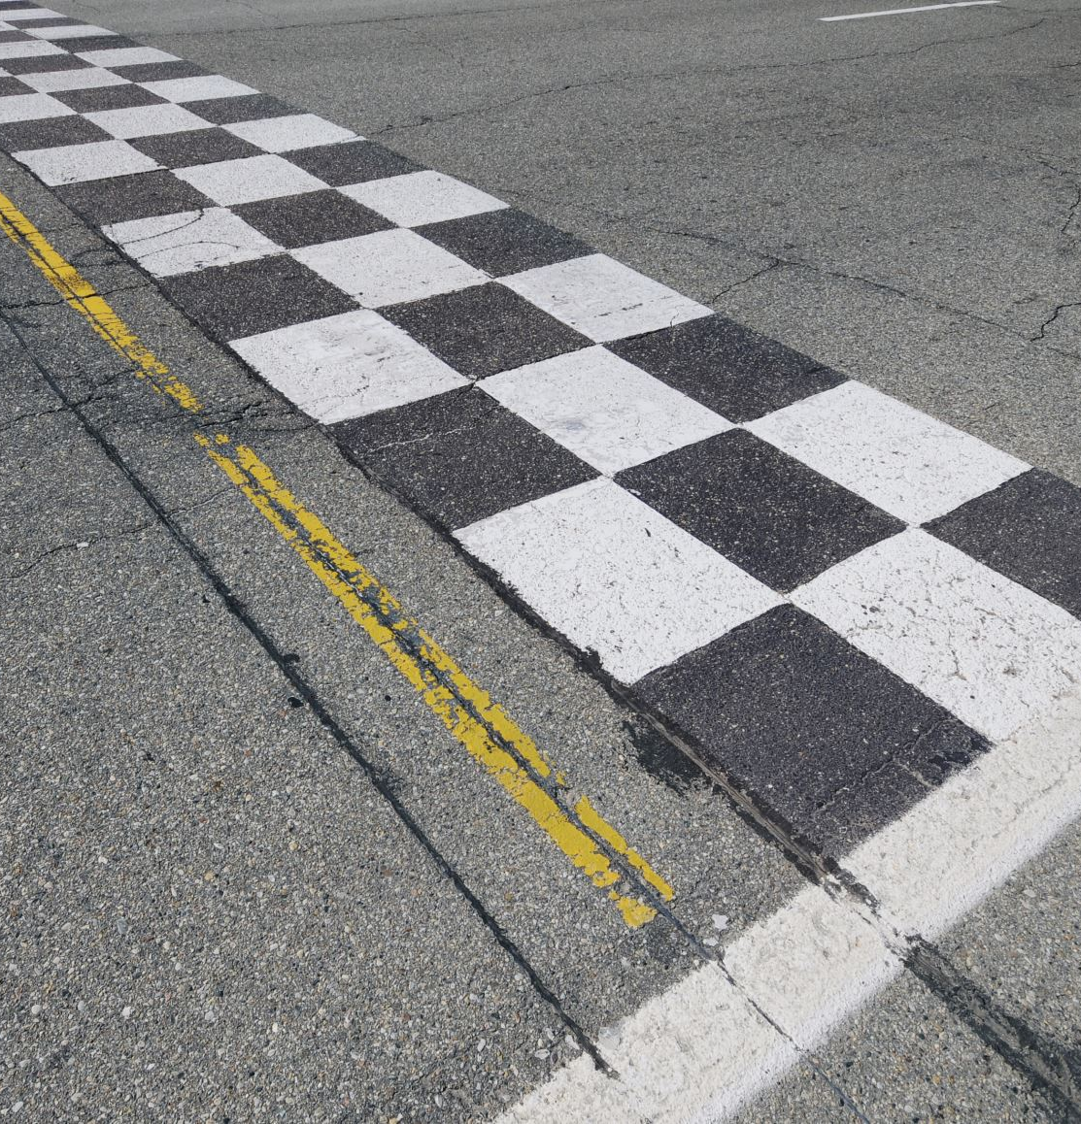
ADDITIONAL REGULATION
During the event, it is not allowed for drivers to drift outside the track on the track territory, any time! In the regulations this point is added and have even the possibility of being disqualified. During the event, it is strictly forbidden to drift on the way to the starting zone or after the finish. The first offense will be fined with up to 100 EUR.
Doing a standing burnout is strictly forbidden.
Drivers are not allowed to drift outside their runs.
During the event, each driver is fully responsible for their actions on the track and for the safety of themselves and others.
During the event, on the track territory leading from the service park to the start zone, a driver takes full responsibility of any accidents with people, who might be on the track. It is suggested to drive no faster than 10 km/h from the service park to the start zone. If driver is catched with faster
speed or drifting from the service park to the start zone, drift organizer can put penalty - 100 eur
The service park will be located in the track territory, where only the race car and service car are allowed to enter.
The maximum allowed speed in the service park is 10 km/h. For the first time, speeding can be punished with a warning or a fine, but if any driver or drivers representative violates this rule with the race and/or service car repeatedly, they will not be allowed to enter the service park anymore.

Slide 20

FINE 50 EUR FOR EACH CASE!

Slide 21
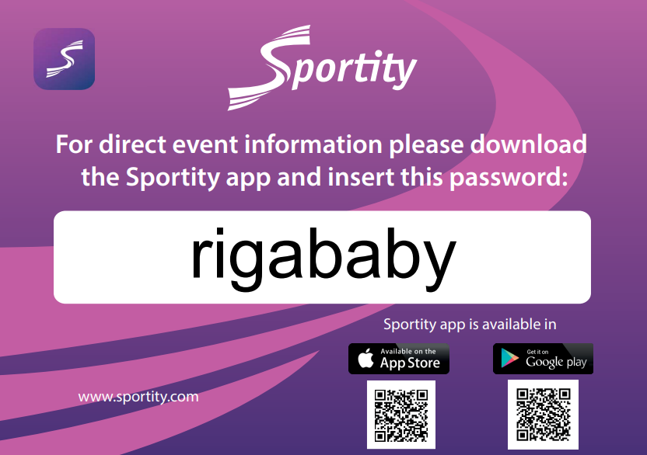
PLEASE JOIN THE SPORTITY APP

Slide 22
WHERE TO EAT?
There will be food court in track, starting from Saturday morning, also there will be breakfast options every morning.
If you go outside and visit city Jēkabpils there is plenty of places to eat just please check working hours.
It is strictly forbidden to bring glass bottles and heavy alcohol into the paddock and race area, also forbidden to drink heavy alcohol in race time in you paddock area!
WHERE TO SLEEP?
WWW.BOOKING.COM, but check also for sure airbnb.com as there is many houses, and beautiful places which are not available in booking.
DRIVERS ALSO HAVE THE OPPORTUNITY TO STAY OVERNIGHT AT THE TRACK
If drivers stay overnight on the track, certain rules must be followed:
if the driver stays in the trailer, the trailer must be "tucked in" in the participant's parking area, so that he is not visually visible much and that there is no mess around during the competition time.
3. if the teams spend the night in tents, then the tents must also be visually "hidden" in the participant's paddock area front, so as not to create an unsportsmanlike view of the drivers boxes and the park as a whole.
The organizer has every right to ask you to drive the trailer or remove the tents at any time.

Slide 23
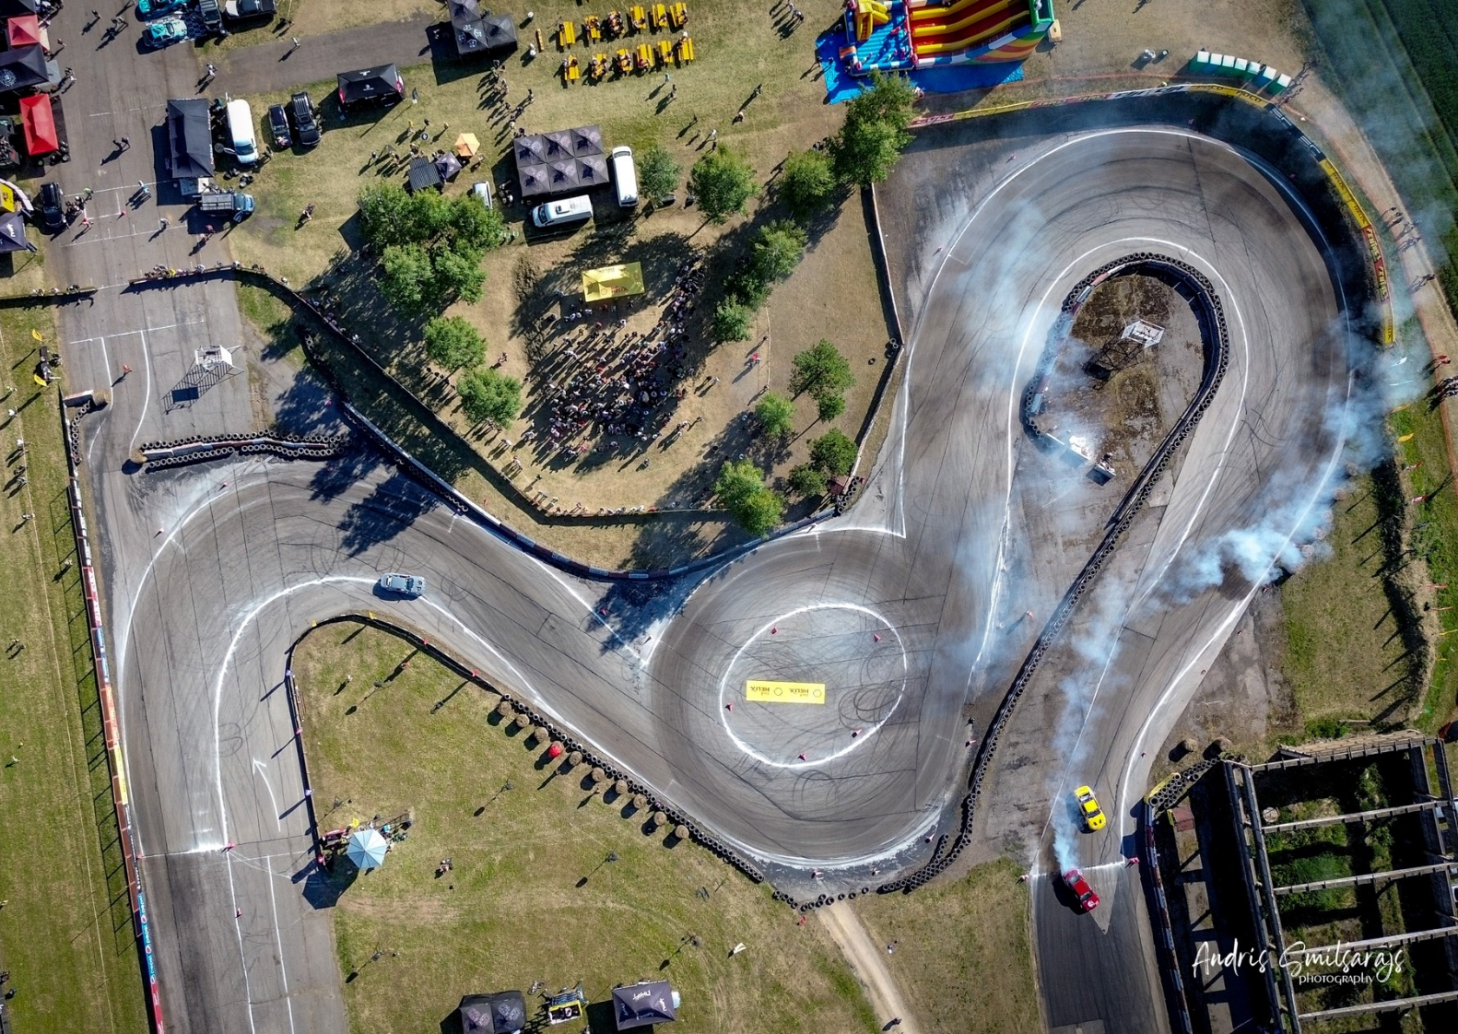
This document has no regulatory role. Information may be changed and updated. Official and current information will be published in SPORTITY
SEE YOU ALL IN RACE TRACK, WELCOME

